Slide 1
By
Md. Saiful Bari Sidddiqui

Slide 2
Background
Air Pollution: A Burning Problem
Necessary to examine what is responsible for poor air quality.

Slide 3
A good way is to determine what differentiates the cities with Least polluted air from those with Most polluted air!

Slide 4
What is responsible for poor air quality in many Cities in the World?

Slide 5
Problem Statement
Do the internal structure and surroundings of these cities have a significant impact on Air Pollution? If it does, what kind of structures in a city correlates to the city being more polluted?
What role does population have in case of Pollution? Does Higher Population Density mean More Pollution?

Slide 6
Data
List of most-polluted cities by particulate matter concentration: https://en.wikipedia.org/wiki/List_of_most-polluted_cities_by_particulate_matter_concentration
A Comparative list of the Most and Least Polluted Cities in the World: https://www.rd.com/list/most-and-the-least-polluted-cities/
Foursquare Developers Access to venue data: https://foursquare.com/
Population Data from Wikipedia: https://en.wikipedia.org/wiki/List_of_cities_proper_by_population_density
Latitude & Longitude of Cities using geopy library: https://github.com/geopy/geopy

Slide 7
Methodology

Slide 8
First Stage
Gathering all resources & importing necessary libraries.
Creating a list each for most & least polluted cities in the world using relevant data sources.
Getting the Latitude & Longitude values of the cities using Python geocoder library an putting all the data in a dataframe.
Finding out all the nearby venues within a certain radius in each city, categorizing them & putting all the results in a dataframe.
Finding out the most common venues from each city using Python pandas toolkit.
Comparing the common venues to find out if there is any pattern of differences between the most & least polluted cities.

Slide 9
Second Stage
Gathering the population densities of all the listed cities and creating a dataframe using this data.
Creating a visualization of the population data using the dataframe, separating most polluted & least polluted cities.
Using the visualization, finding out if higher population density in cities corresponds to more pollution.

Slide 10
Results

Slide 11
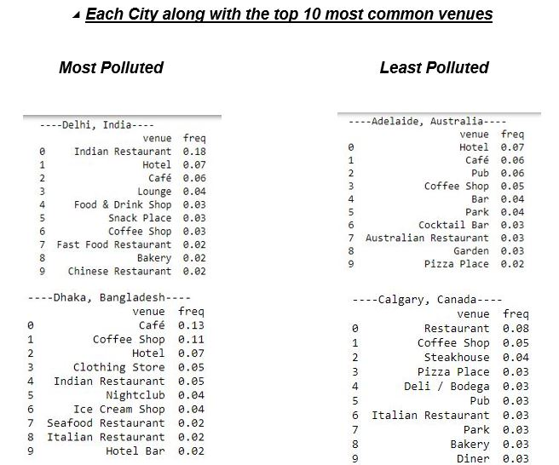
Same types of venues consisting of Restaurants, Hotels, Coffee Shops etc.

Slide 12
Conclusion
The most common structures and venues within a city are pretty much the same in most of them and they have little effect in making a city a polluted one. Some significant venues might seem to be exceptions but the regular surroundings have little to no impact in this case, hence uncorrelated to pollution.

Slide 13
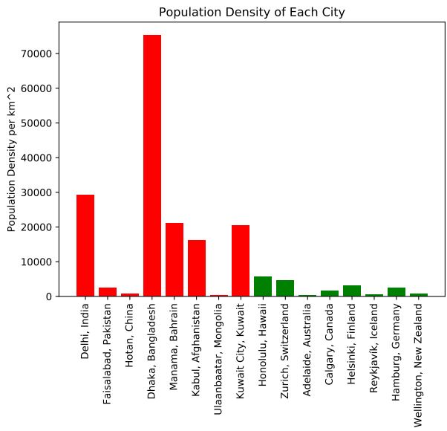
Cities with higher Population Density tend to be more polluted

Slide 14
Conclusion
Even though there can be many other factors, Densely populated cities tend to be more polluted than less densely populated cities. So, there is a positive correlation between population density & pollution.

Slide 15
For further information on this study, check the Github repository : https://github.com/Saiful185/Data_Science_Capstone

Slide 16
Thank You!

